Slide 1
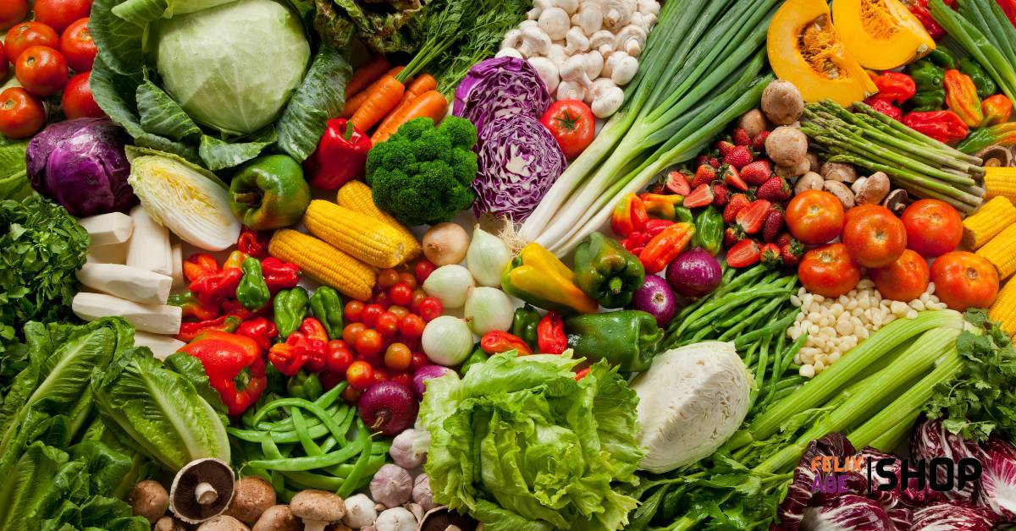
Full-Stack Marketing Strategy
EGE FARM
Abdulkareem Abideen
TS Academy Capstone Project Module 10
Product Marketing Strategy
Ilorin, Kwara State, Nigeria
2026

Slide 2
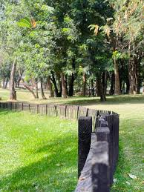
Business Overview
Farm Name: EGE FARM
Location : Ilorin, Kwara State, Nigeria
Ownership: Sole Proprietorship
Farming Method: Open-field cultivation
Practice: 100% Organic (No Chemicals)

Slide 3
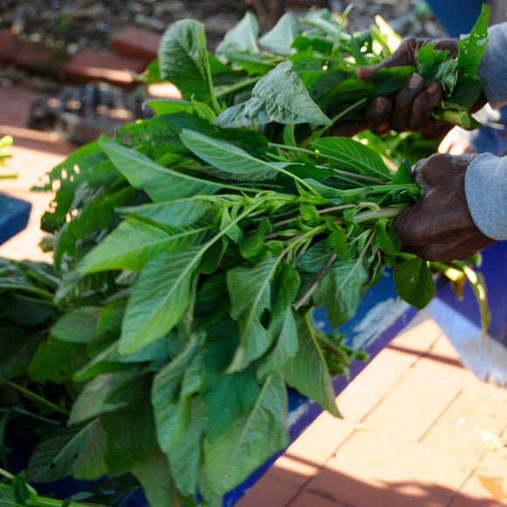
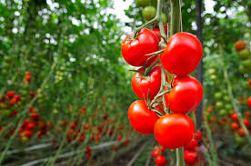

Product Portfolio
Leafy Vegetables: Spinach, Lettuce, Ugwu
Fruit Vegetables: Tomatoes, Peppers, Okra
Freshly harvested daily
Distribution: Direct farm sales + home delivery within Ilorin

Slide 4
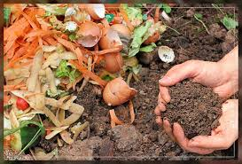
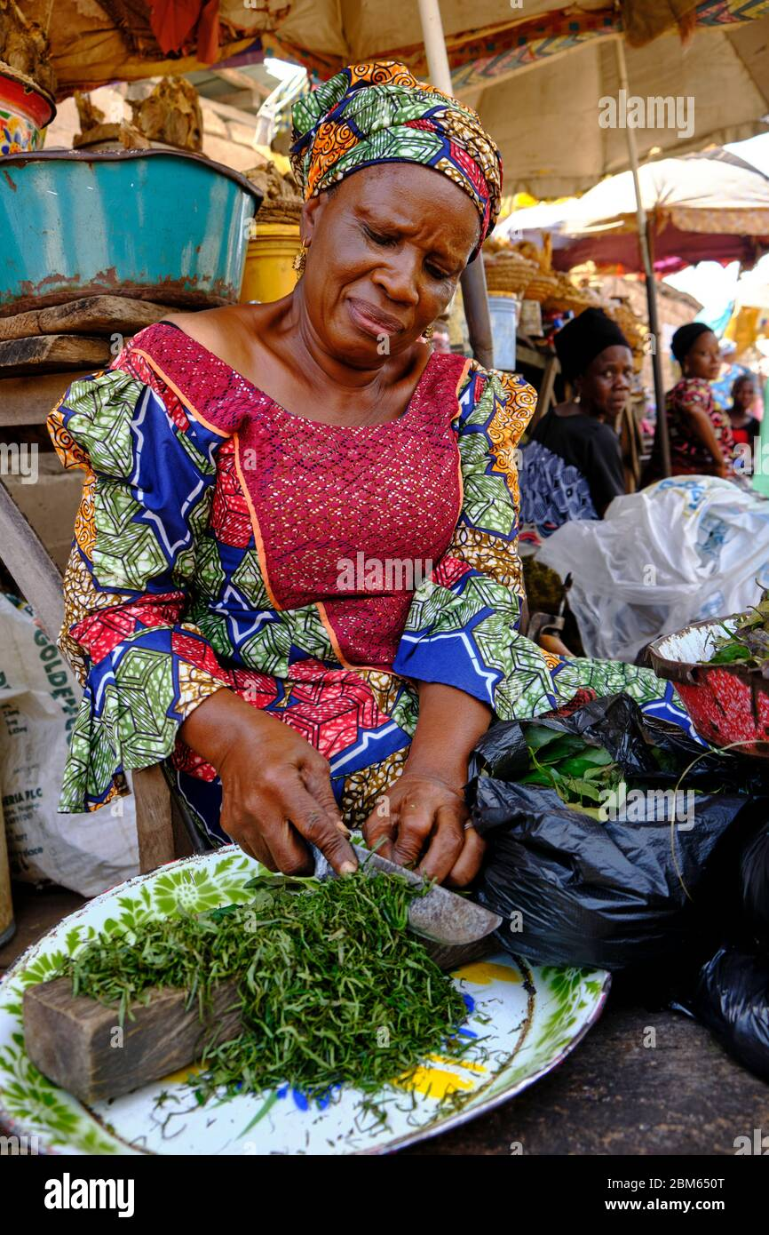
Unique Value Proposition
100% organic produce (chemical-free)
Fresher than open market produce
Affordable pricing model
Convenient home delivery
Trusted local farm brand

Slide 5
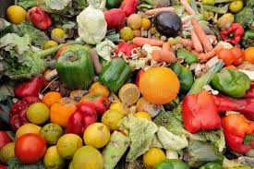
Market Problem
Many vegetables sold in open markets contain chemical residues.
Produce often loses freshness before reaching consumers.
No structured delivery service for fresh farm produce in Ilorin.
Restaurants struggle to find reliable fresh suppliers.

Slide 6
Target Market Segmentation
Primary: Health-conscious households in Ilorin
Working-class families seeking convenience
Secondary: Restaurants and hotels
Food vendors and local caterers

Slide 7
Audience Interests
Target Interests
Healthy eating
Organic food
Cooking
Fitness lifestyle
Agriculture

Slide 8
90-Day Marketing Objectives
Generate 200 qualified leads from Ilorin residents.
Convert at least 60 customers from those leads.
Achieve ₦1.5M in vegetable sales revenue.
Grow social media audience to 2,000 followers.

Slide 9


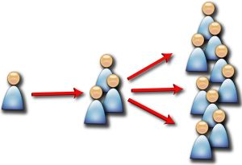
Channel Strategy
Organic: Instagram, Facebook, WhatsApp Business, TikTok
Paid: Facebook & Instagram Lead Ads
Google Business Profile optimization
Referral & word-of-mouth marketing

Slide 10
Customer Acquisition Funnel
Awareness: Paid social ads & organic content
Consideration: WhatsApp inquiries & testimonials
Conversion: Discount bundle offers
Retention: Follow-up messages & loyalty incentives

Slide 11
Campaign 1 – Facebook Lead Generation
Target: Ilorin residents (Age 23–55)
Budget: ₦5,000/day for 14 days
Ad Message: Fresh organic vegetables delivered to your doorstep
CTA: Send Message
KPIs: CTR, Cost per Lead, Conversion Rate

Slide 12
Campaign 2 – WhatsApp Conversion Strategy
Send digital catalog & farm images
Offer bundle discounts
Limited-time free delivery
KPIs: Response rate, Order rate, Repeat purchase rate

Slide 13
Mock Campaign Performance (Projected)
Ad Spend: ₦70,000
Leads Generated: 240
Cost per Lead: ₦292
Orders: 65
Revenue: ₦1,300,000
Conversion Rate: 27%

Slide 14
Performance Analysis
Strong engagement indicates high demand for organic vegetables.
Restaurants showed higher purchase frequency than households.
Some households showed price sensitivity.
Customers responded positively to home delivery.

Slide 15
Optimization & Growth Strategy
A/B testing of ad creatives
Introduce weekly vegetable subscription box
Launch customer referral program
Retarget engaged audiences
Partner with local health influencers

Slide 16
6-Month Growth Plan
Scale paid ads across Kwara State
Expand B2B partnerships
Develop branded packaging
Implement CRM tracking system
Launch farm brand awareness campaign

Slide 17
Case Study Summary
Built a structured digital marketing system for a local farm.
Demonstrated how performance marketing can scale agriculture businesses.
Positioned EGE FARM as a trusted organic vegetable brand in Ilorin.

Slide 18
Thank You
EGE FARM - Growing Healthy Communities

